Slide 1
Online book store
Kipchakpayev Madiyar

Slide 2
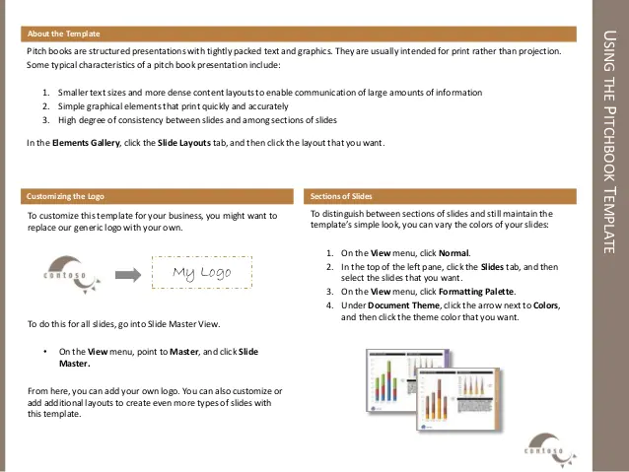

Slide 3
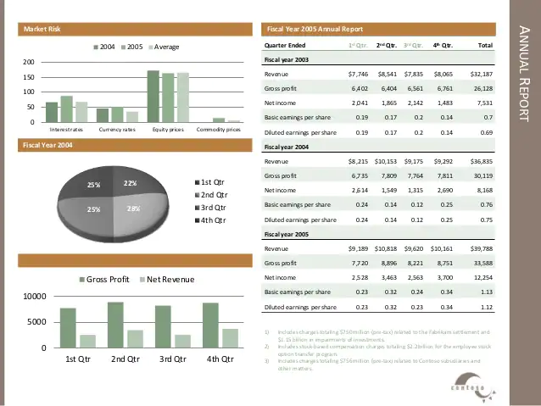

Slide 4
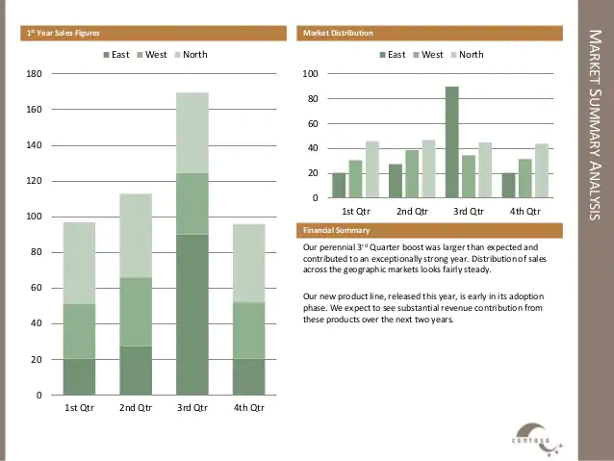

Slide 5
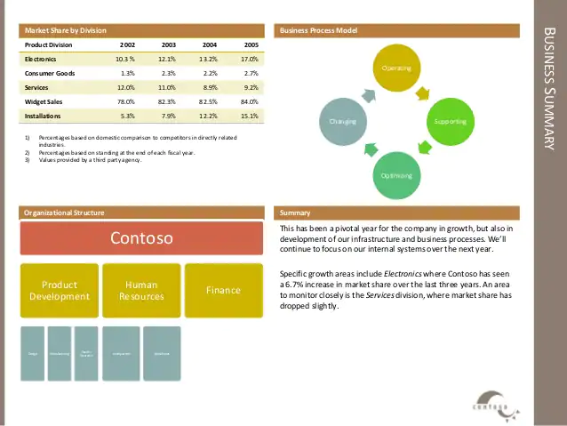

Slide 6
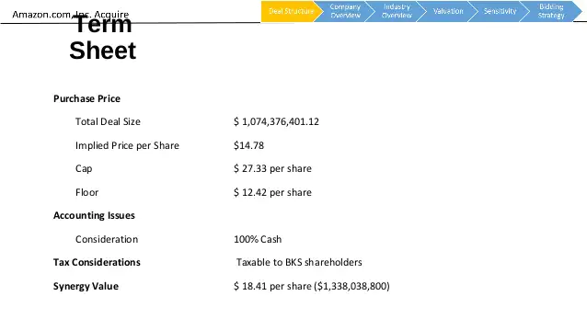

Slide 7
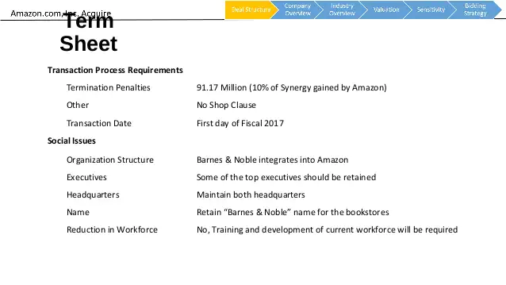

Slide 8
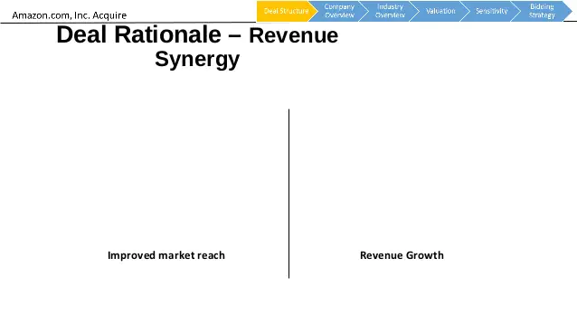

Slide 9
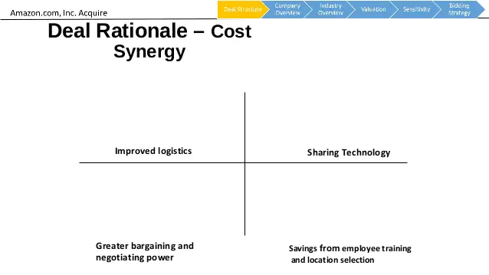

Slide 10
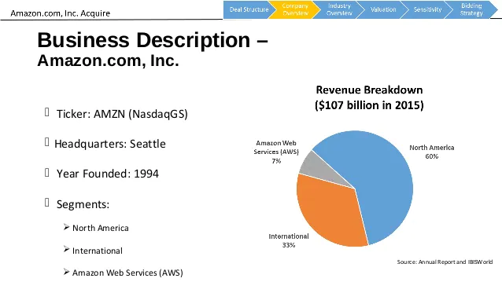

Slide 11
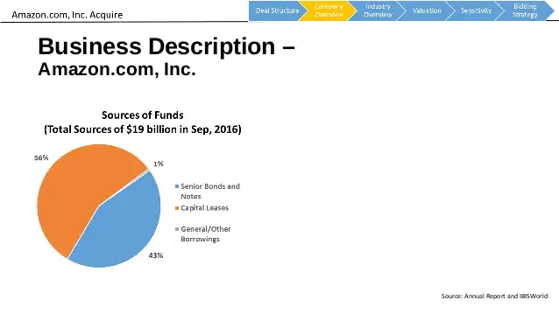

Slide 12
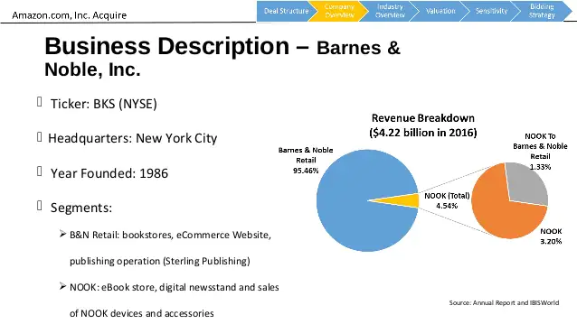

Slide 13
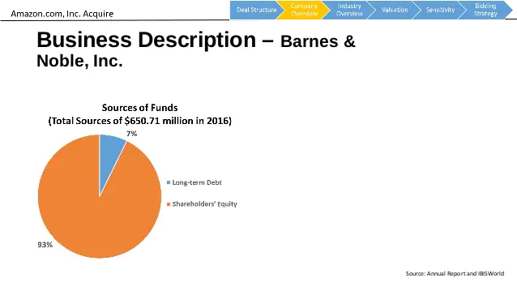

Slide 14
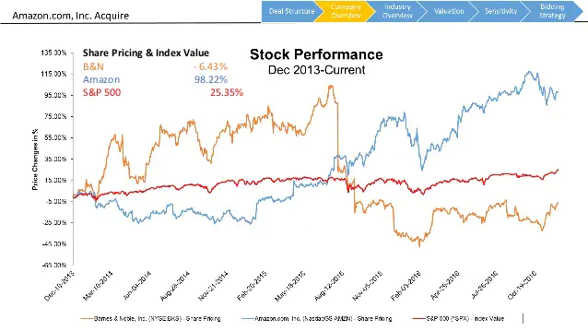

Slide 15
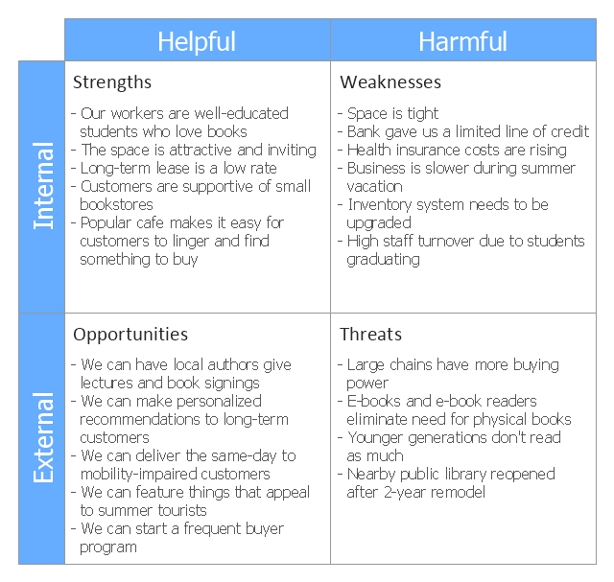

Slide 16
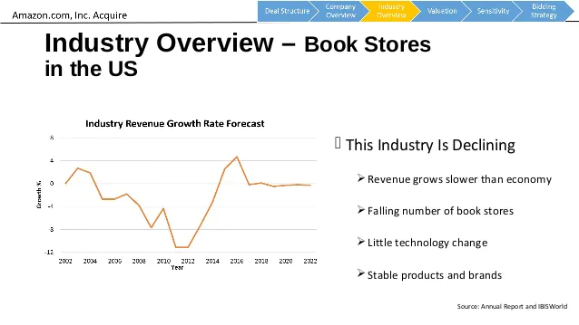

Slide 17
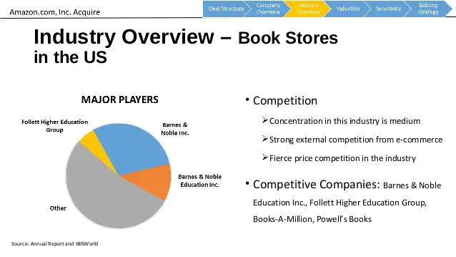

Slide 18
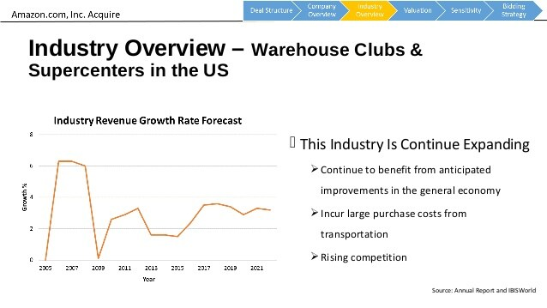

Slide 19
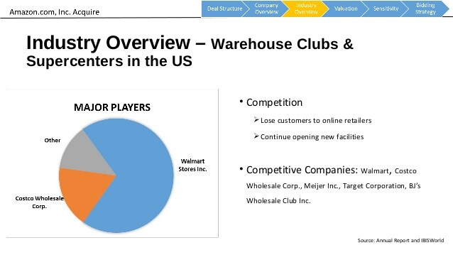

Slide 20
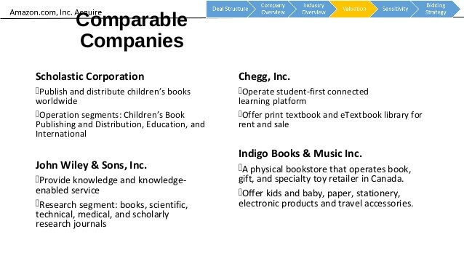

Slide 21
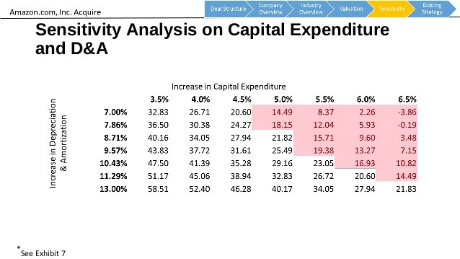

Slide 22
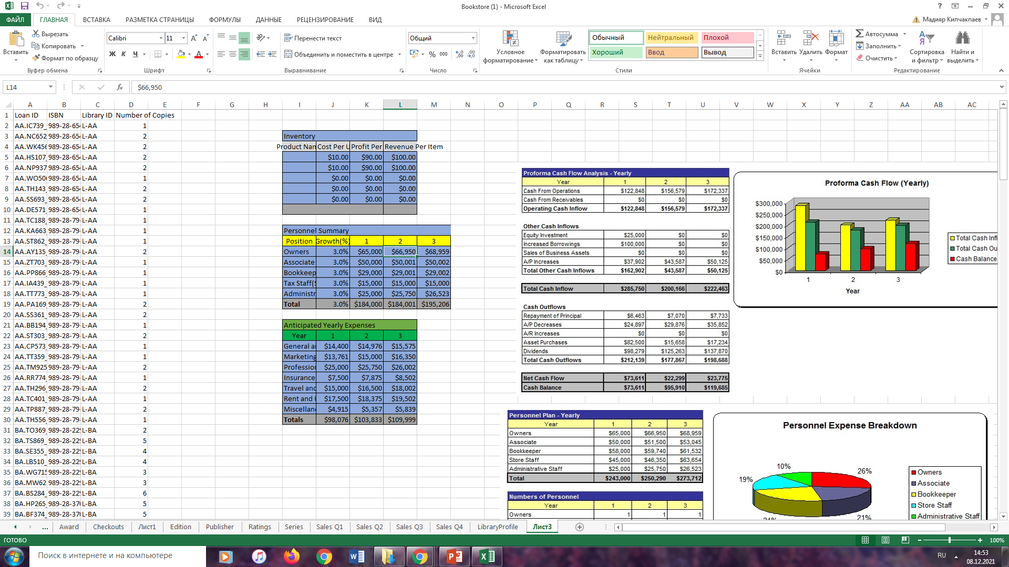

Slide 23
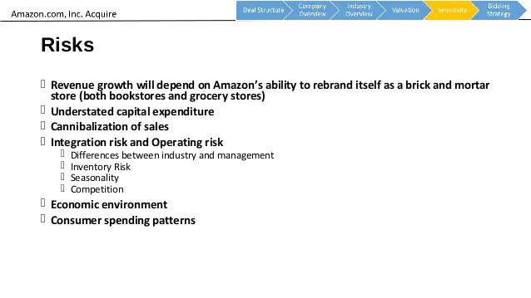

Slide 24
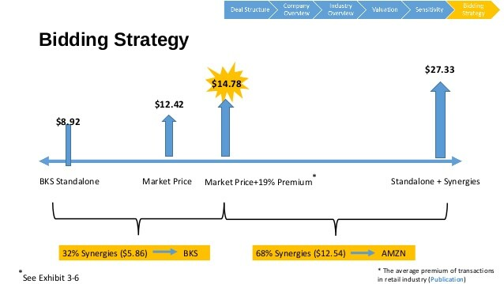

Slide 25
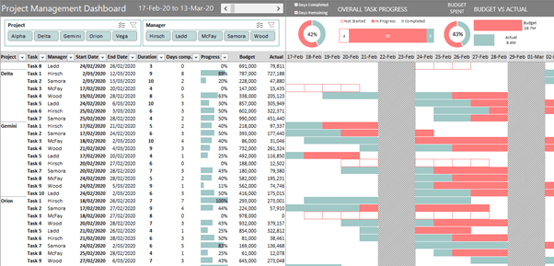
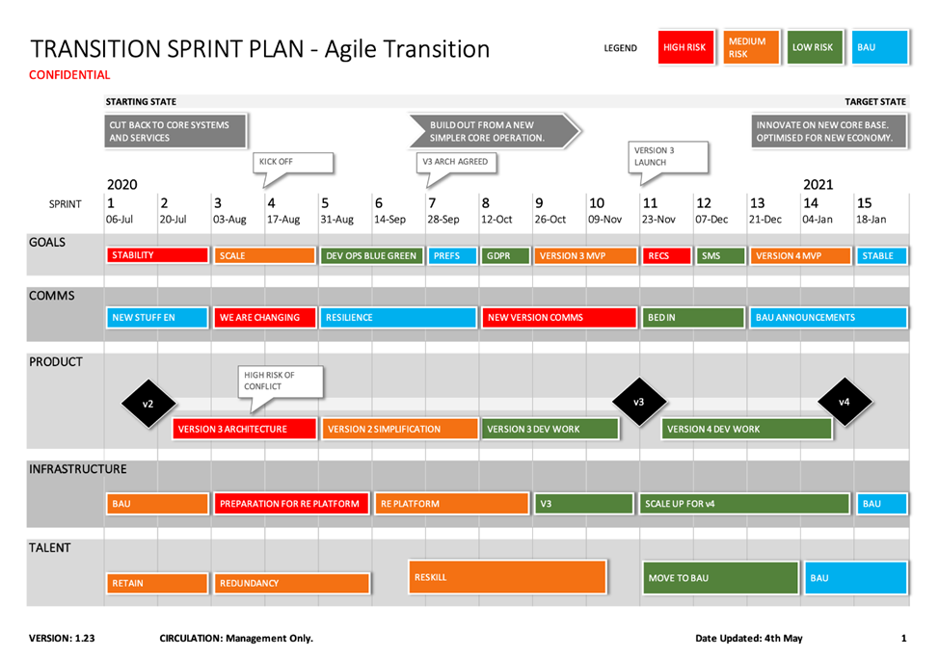

Slide 26
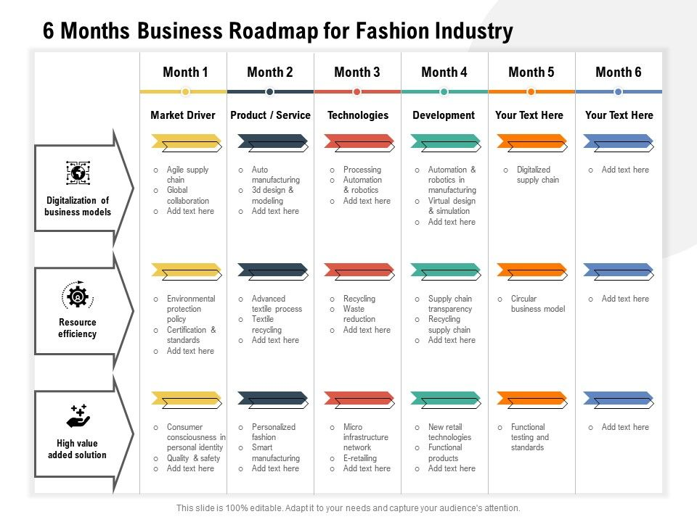
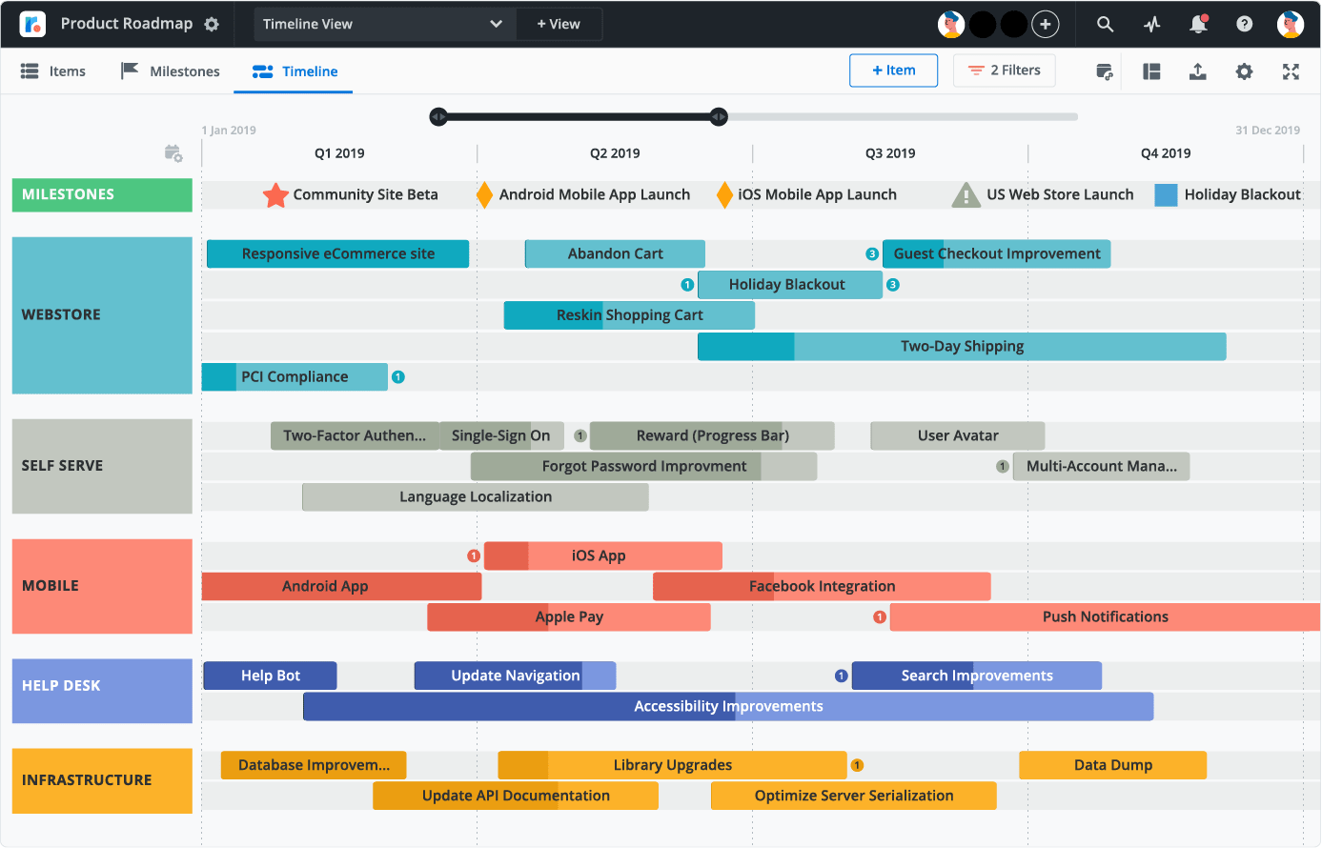

Slide 27
Using the Financial Statements
The Bookstore’s financial reports include the Statement of Net Position, the Statement of Revenues, Expenses and Changes in Net Position and the Statement of Cash Flows.
The statements are prepared in accordance with Governmental Accounting Standard Board (GASB) principles, which establish standards for external financial reporting for public colleges and universities. The financial statements are presented using the economic resources measurement focus and the accrual basis of accounting. Under the accrual basis, revenues are recognized when earned and expenses are recorded when an obligation has been incurred.
Statement of Net Position
The Statement of Net Position presents the financial condition of the Bookstore at the end of the fiscal year and reports all assets and liabilities of the Bookstore.
The amounts in these statements represent the assets available to continue the operations of the Bookstore and also identify how much the Bookstore owes vendors and all other parties. The difference between total assets and total liabilities, net position, is one indicator of the current financial condition of the Bookstore. The change in net position measures whether the overall financial condition has improved or deteriorated during the year.

Slide 28
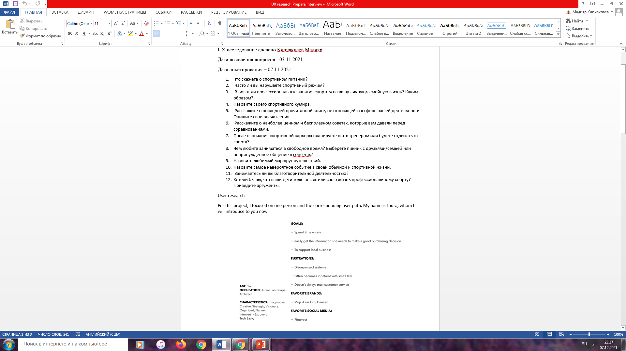
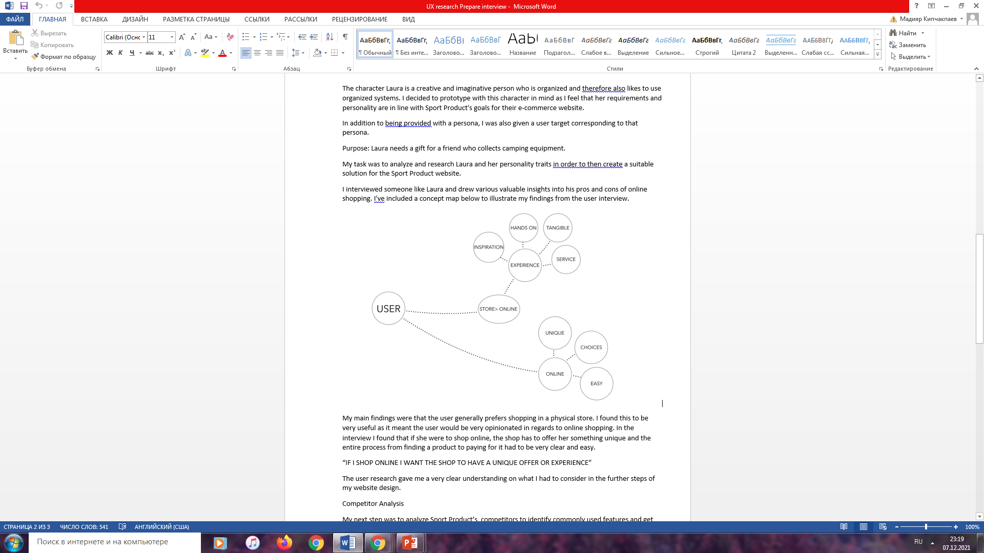
UX research

Slide 29
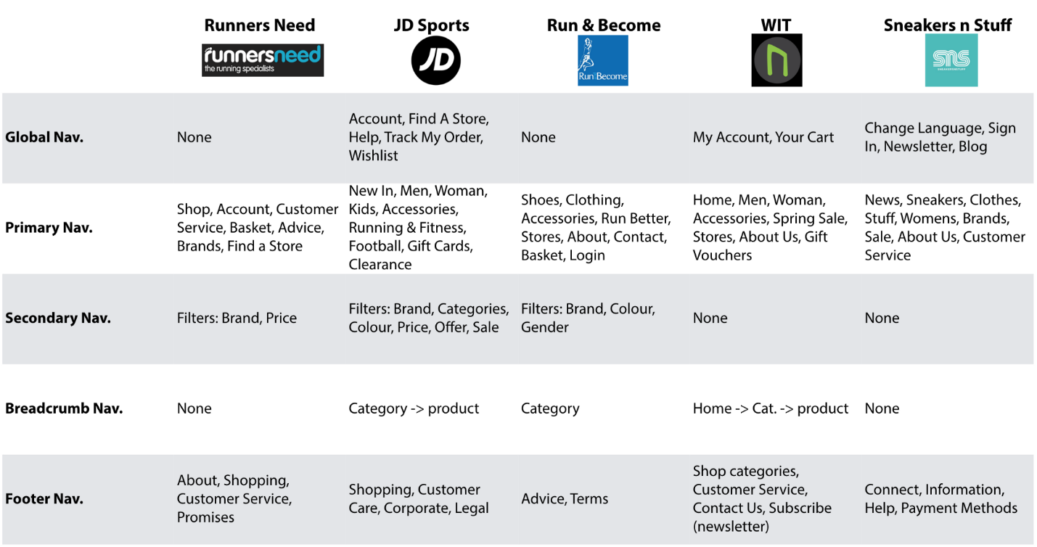
The elements analysis helped me get an idea on how I could structure my website prototype but it also displayed that there is no unified correct way of doing it.
Further, I wanted to see what features competitors use on their websites to enhance the experience for their users. I created a large spreadsheet listing all findings after which I summarized the strengths and weaknesses in a table.

Slide 30

We started our career in graphic design working for a local sports company. During my time there, I saw a lot of great things and worked with many awesome people. However, I also noticed that their use of technology, or lack thereof, is making them fall behind with regards to gaining more business.

Slide 31
Stakeholder goals
Stakeholders should be able to order their equipment and customize and preview their garments as well as set up online shops for their students in an efficient manner. Having prices for screen printing and embroidery, previewing the designs, and being able to put in your custom orders online are missing from the current website. Having these elements would drive up business.

Slide 32
UX Problems
There are a few main challenges foreseen in implementing these changes. The first is that the owner is technology averse and does not see the need to change what she’s been doing for the past 25+ years. Paper-based orders and invoices are still being used, so the margin for error increases, the time spent filling out orders increases, and the ability for a customer to have the ordering in his/her own hands is not present at all.

Slide 33
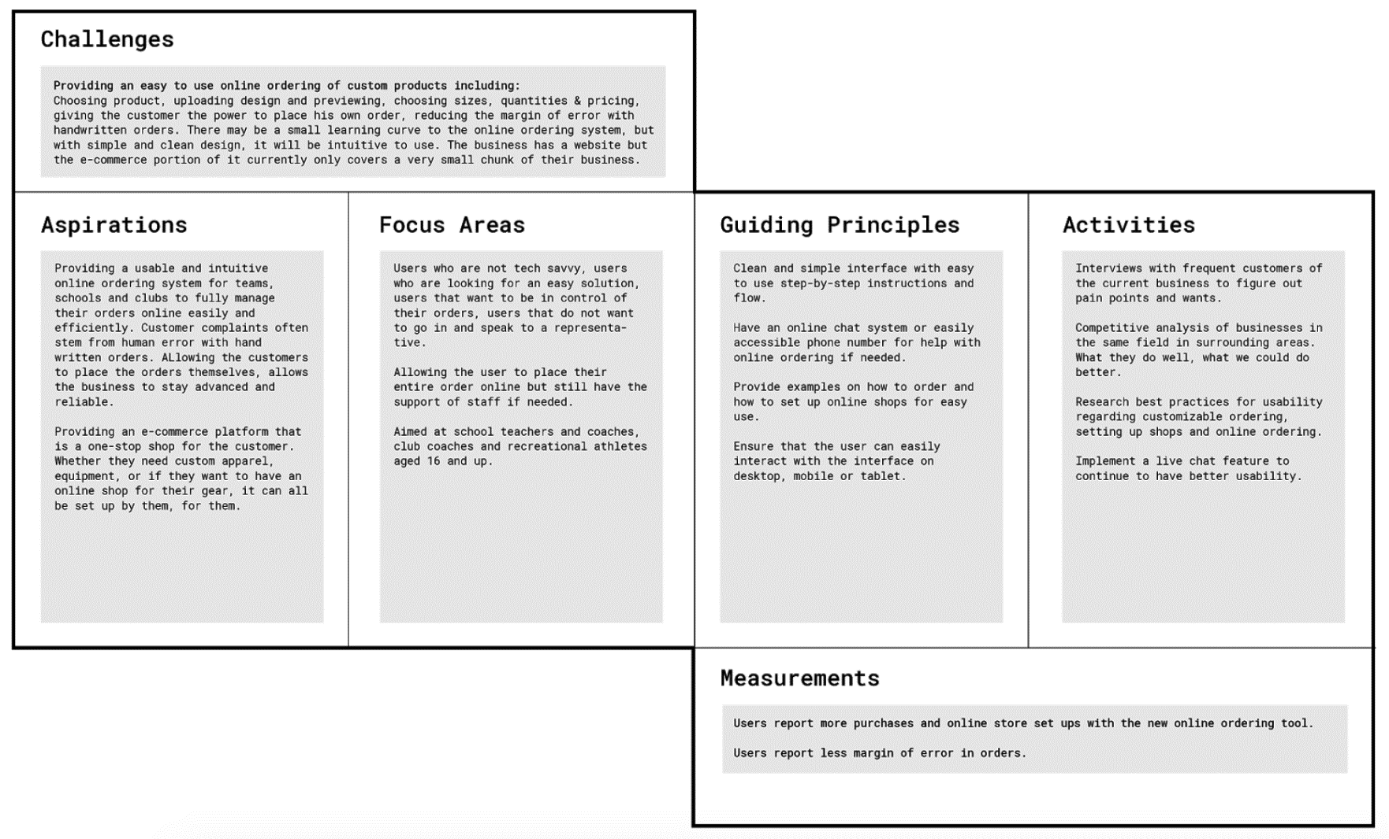
Info
Workplace: Personal Project
Services: UX
Year: 2018
Role: Research
Duration: 3 months
Environment: Solo
UX Research

Slide 34
Survey

Slide 35
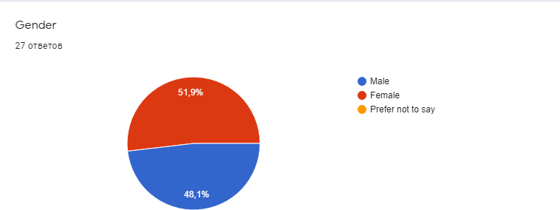
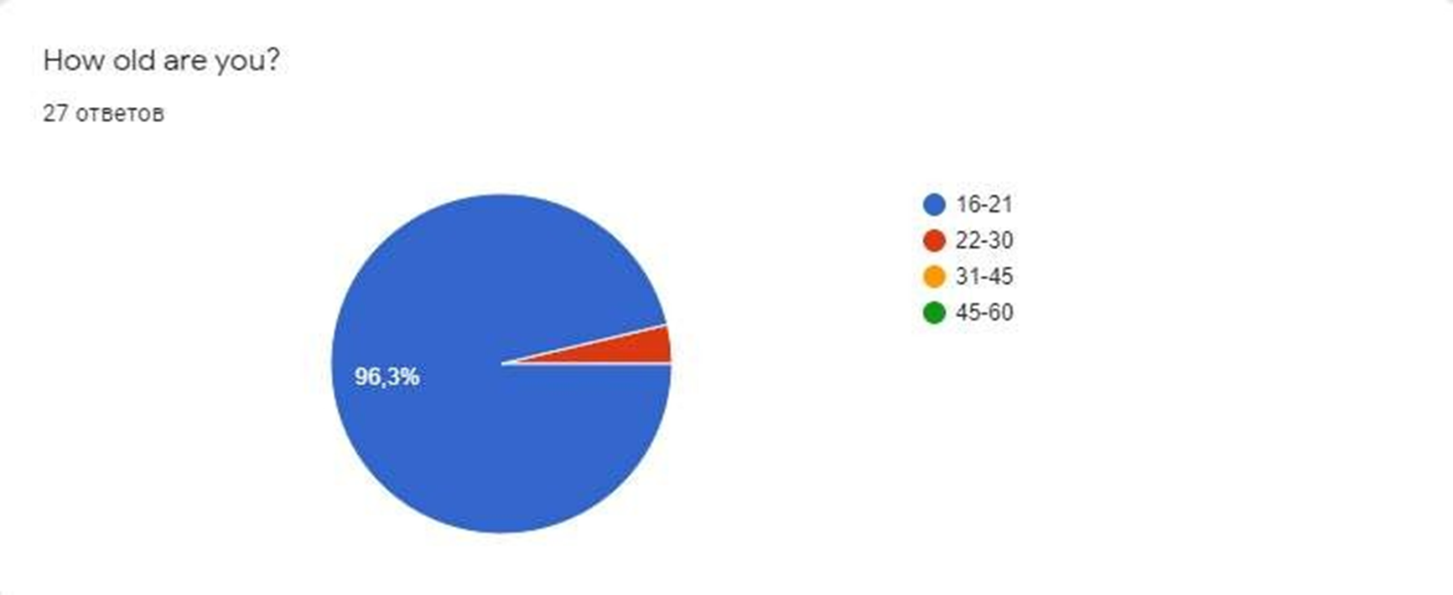
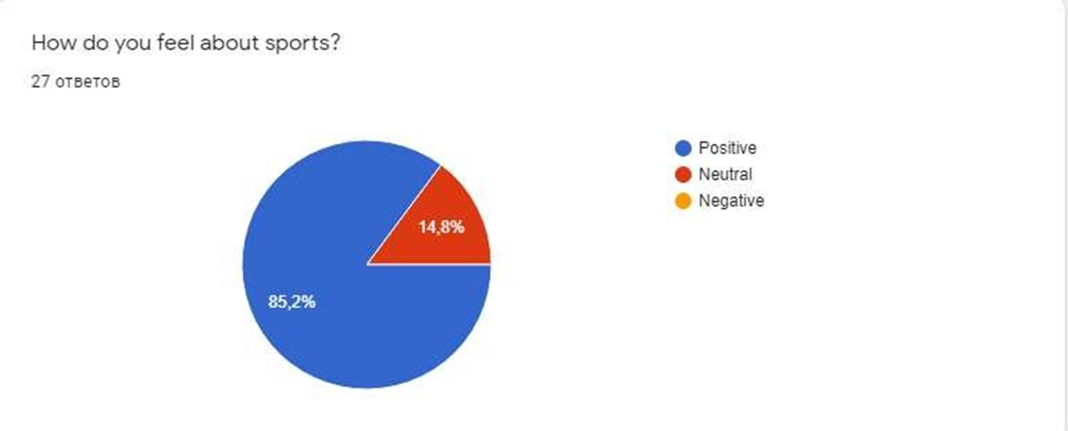
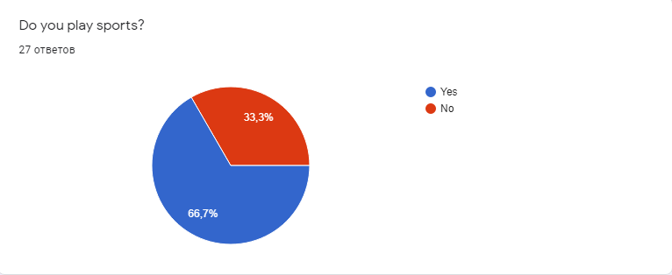
Our project is about an online sports goods store.

Slide 36
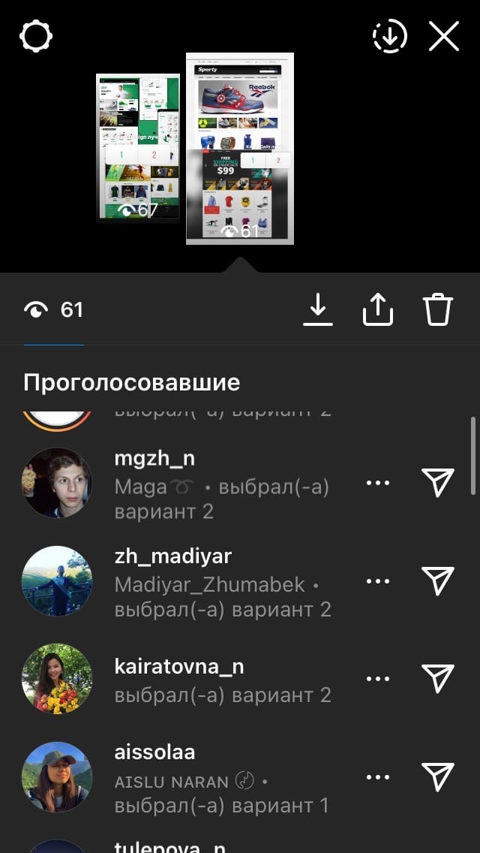
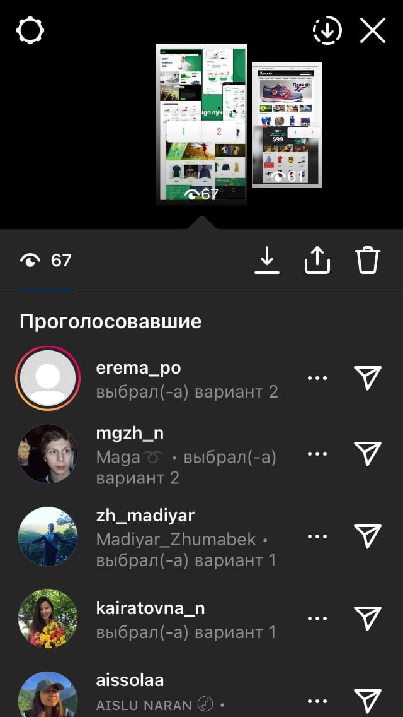
Image 2. Survey results

